Slide 1
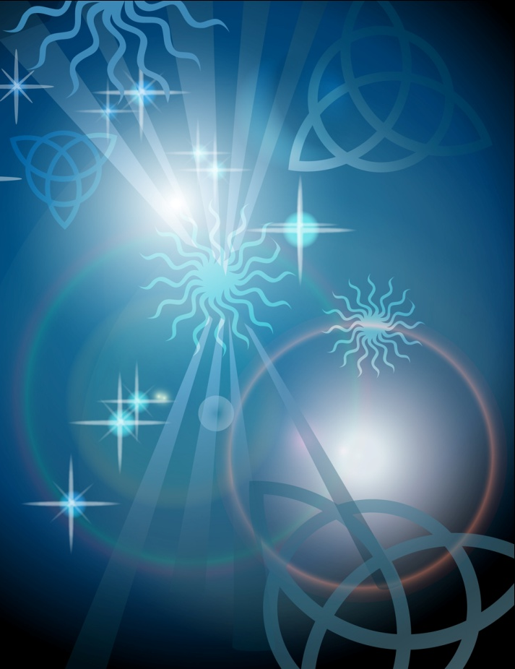
Listening to Light
MJ Tykoski
Cooper Junior High School
Wylie, Texas

Slide 2
Three astronomers…
…are trying to decide what wavelengths of light they should use when looking at the constellation Orion…

Slide 3
Who does your group agree with?
Statement 1: Dr. Moon says we should look at Orion in the visible spectrum because that is what we can see with our eyes. What’s the point in looking at any other part when we can’t even see it?

Slide 4
Who does your group agree with?
Statement 2: Dr. Luna says we should look at Orion in the infrared because it has wavelengths longer than visible light. Longer wavelengths can get through the gas and dust in nebulas.

Slide 5
Who does your group agree with?
Statement 3: Dr. Monde says we should look at Orion in the ultraviolet because it does not have as much energy as visible or infrared. Too much energy can be dangerous for humans and we don’t want to get hurt.

Slide 6

Who does your group agree with?
Dr. Moon: Visible
Dr. Luna: Infrared
Dr. Monde: Ultraviolet

Slide 7

The Set Up

Slide 8
What happens when you shine the following on the photocell?
Data Table #1: Classroom Lights
Data Table #2: Flashlight
Data Table #3: UV Light

Slide 9
In your notebook…
…describe all the energy transformations that happen when you are shining a light on the photocell

Slide 10
What happens when you shine the following on the photocell
Data Table #4: Remote Control

Slide 11

Infrared light can be picked up on a photocell!
It’s light!

Slide 12
If astronomers…
…only look at visible light, they are missing most of the picture!
Look at the picture of Orion in visible light. Where would you point your telescope?

Slide 13
Now look at Orion in infrared light.
Would you still look in the same area?
Where would you look that you hadn’t considered before?

Slide 14
Listening to Light
A student pulls the infrared LED out of a remote and connects it to an MP3 player. Then the student turns the MP3 player on, and holds the infrared LED close to the photocell. What will the student hear coming out of the amplifier/speaker?
Describe the energy transformations from the MP3 player to the amplifier/speaker.
An astronomer is going to look at M16, the Eagle Nebula. What wavelength would be best for viewing the Eagle Nebula: visible, infrared, or ultraviolet? Why?

