Slide 1
A Night at the IRTF

Slide 2
Answer the following questions on a scale of 1-4
1. I know nothing about this
2. I know a little about this
3. I know some about this
4. I know a lot about this

Slide 3
Answer the following questions on a scale of 1-4
1. I know what astronomers do on an observing run.
2. I know how astronomers use infrared light.
3. I know how astronomers use spectra.

Slide 4
A Night at the IRTF

Slide 5
Where you’ll be working
The Infrared Telescope Facility (IRTF) on Mauna Kea in Hawaii
The Texas Echelon Cross Echelle Spectrometer

Slide 6
The astronomers you’ll work with….
Dr. John Lacy (The University of Texas at Austin)
Dr. Tommy Greathouse (Southwest Research Institute)
www.utexas.edu/astro/fac_j_lacy.html

Slide 7
1. What is the electromagnetic spectrum?
The electromagnetic spectrum is all types of light including radio, infrared, visible, ultraviolet, x-rays, and gamma rays.

Slide 8
2. How is infrared different from visible light?
The wavelength is longer, the energy is less, and we can’t see infrared.

Slide 9
3. What is spectroscopy?
Spectroscopy is the study of light when it is spread into its component colors. It is used to analyze light; for example, to find out what chemicals are present.

Slide 10
4. When you use a diffraction grating, what do you see?
When you use a diffraction grating, you see a spectrum of color or a pattern of bright colored lines; sometimes you see a pattern of dark lines on the colored spectrum.

Slide 11
5. Can you see pictures in the infrared with your eyes? Why or why not?
No, we can’t.
Our eyes cannot detect wavelengths that long.

Slide 12
6. Can you see spectra in the infrared? Why or why not?
We wouldn’t see it the same way we see visible spectra since we can’t see infrared light with our eyes.

Slide 13
False Color Imaging
Assigning colors we can see to wavelengths we can’t see.
Like a cross between translating between two languages and a color-by- number picture

Slide 14
Infrared Astronomy is very important!
www.nasa.gov
Orion in visible Orion in infrared
(false color)
SEE HOW MUCH WE MISS???

Slide 15
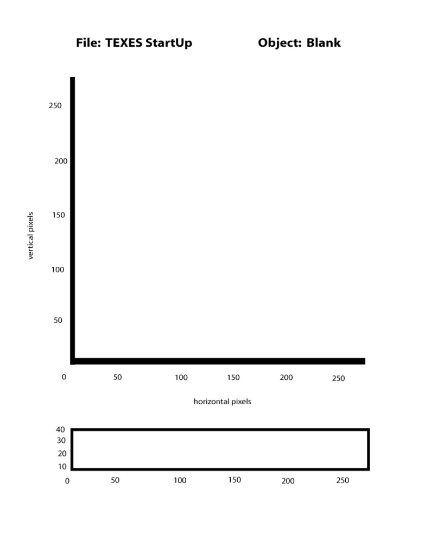
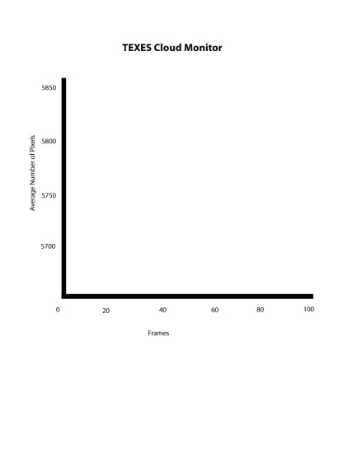
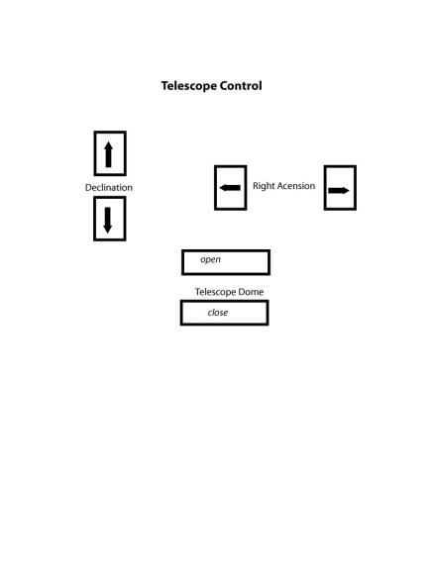
The TEXES Screen
A
C
D
B

Slide 16
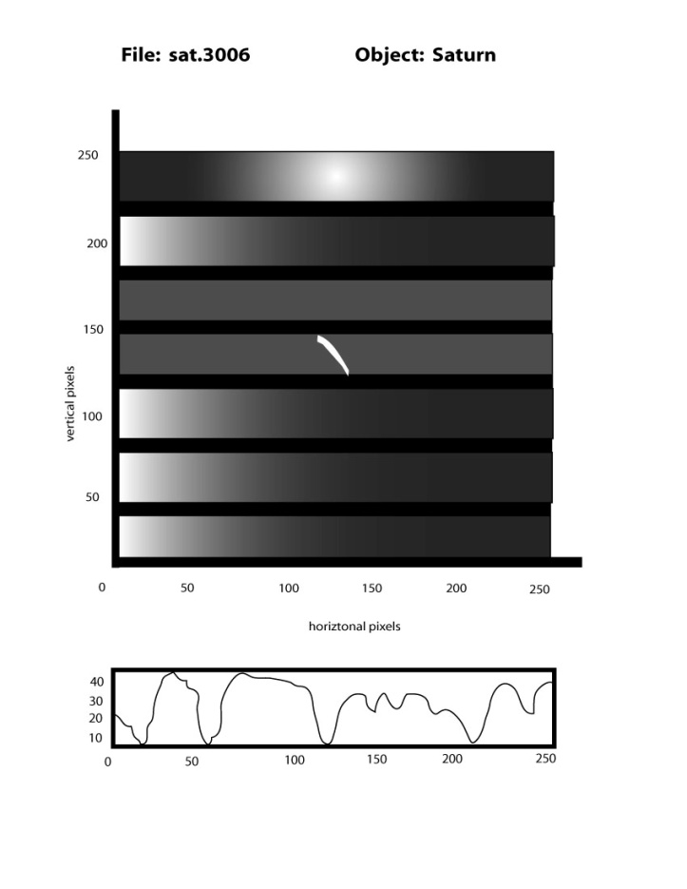
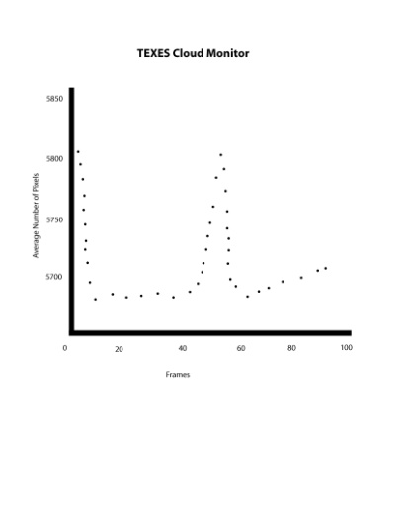
Southern Hemisphere of Saturn

Slide 17
What do you think the wavenumber of this spectrum is?
Between 584-588

Slide 18
Chemical | Wavenumber
Ar⁺⁴ | 699
H₂ | 586
CH₄ | 1244
NE ⁺⁴ | 412
S ⁺³ | 952

Slide 19
What chemical have you just identified in the atmosphere of Saturn?
Hydrogen!

Slide 20
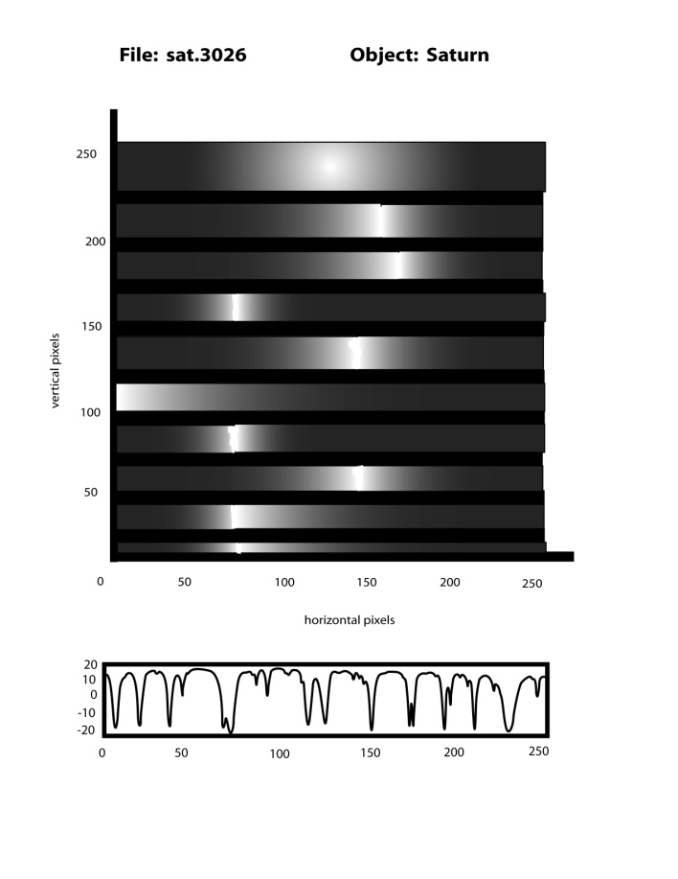
Northern Hemisphere of Saturn

Slide 21
What do you think the wavenumber of this spectrum is?
Between 1240-1250

Slide 22
Chemical | Wavenumber
Ar⁺⁴ | 699
H₂ | 586
CH₄ | 1244
NE ⁺⁴ | 412
S ⁺³ | 952

Slide 23
What chemical have you just identified in the atmosphere of Saturn?
CH₄ Methane! Natural Gas!

Slide 24
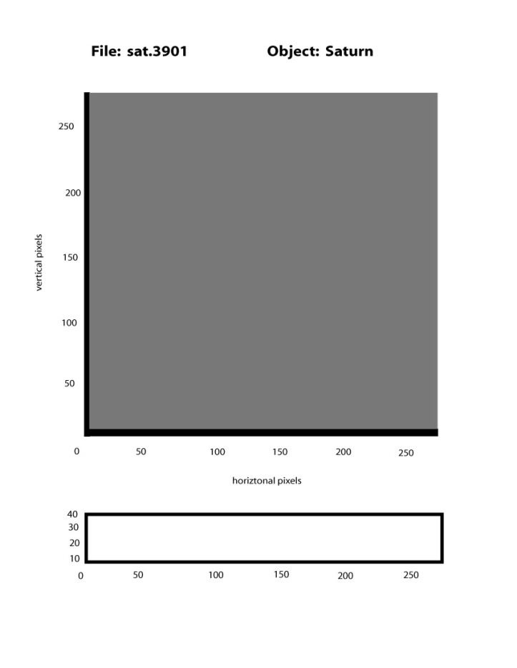
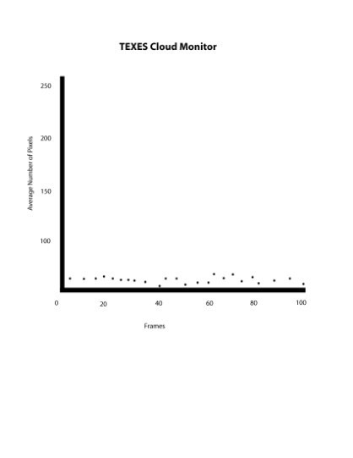
Equator of Saturn

Slide 25
What do you think is happening?
According to the cloud monitor, no light is getting to the pixels.
Clouds are blocking the light from Saturn.
If there are clouds, there could be rain.

Slide 26
What needs to be done?
The telescope needs to be closed, so it doesn’t get wet.

Slide 27
Answer the following questions on a scale of 1-4
1. I know nothing about this
2. I know a little about this
3. I know some about this
4. I know a lot about this

Slide 28
Answer the following questions on a scale of 1-4
1. I know what astronomers do on an observing run.
2. I know how astronomers use infrared light.
3. I know how astronomers use spectra.

Slide 29
On the back…
Add one statement about something you learned
Add one statement about something to be changed

Slide 30
Self Assessment Results

Slide 31
I know what astronomers do on an observing run.
Pre-Activity: 1.46
Post-Activity: 3.15

Slide 32
I know how astronomers use infrared light.
Pre-Activity: 1.97
Post-Activity: 3.30

Slide 33
I know how astronomers use spectra.
Pre-Activity: 2.54
Post-Activity: 3.37

Slide 34
Other provocative comments…
An observing run is like a science project.
You can’t leave a telescope open when it’s raining.

Slide 35
Other provocative comments…
Astronomers work in front of the computer more than on the telescope.
The cloud monitor is very important!

Slide 36
Acknowledgements
Thank you to Drs. John Lacy and Tommy Greathouse for sharing their expertise. Thank you to the National Science Foundation for funding my travel to the IRTF.
Thank you to NASA for funding the EXES Teacher Associate Program at the Astronomy Department of the University of Texas at Austin.

